Slide 1

Data Science Joint Education Program INFO 102 Introduction to Information Systems
Chapter #8: Collaborating with Technology

Slide 2
Introduction

Slide 3
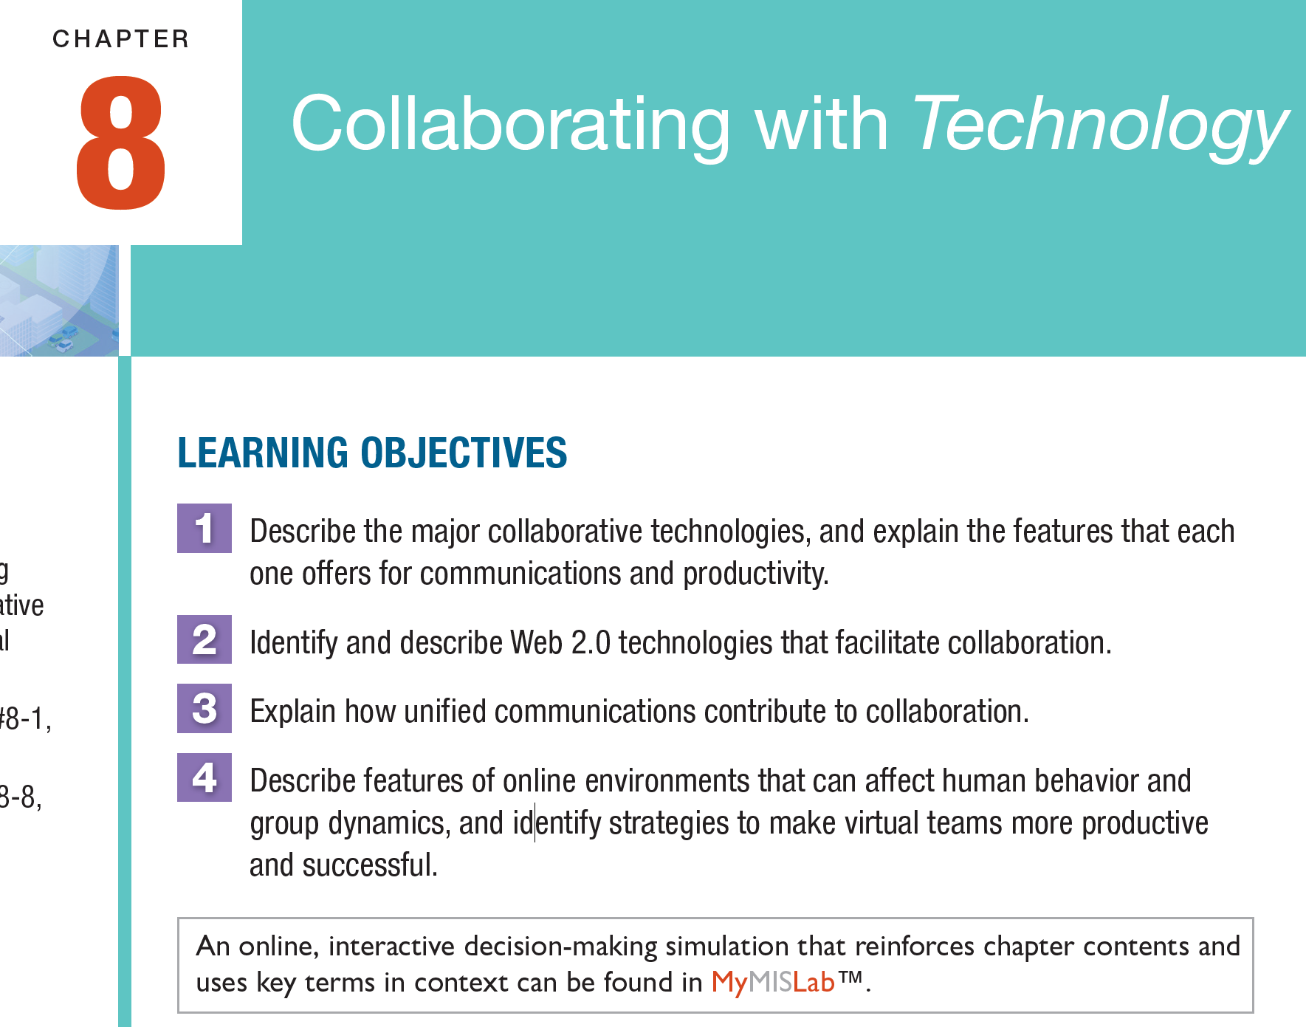

Slide 4
Overview
This focus of this chapter is:
The major technologies used for collaboration along with the human interactions supported
An exploration of why collaborative technologies affect human behaviors
How can collaborative technologies be used to their best advantage
Many human relationships have some virtual component
Collaborative technologies support these interactions
Moreover: the interaction go well beyond email, text messages, and telephone conversations
Collaborative technologies offer opportunities for human interaction, but human behaviour and group dynamics can be affected in unexpected ways

Slide 5
Chapter #8 Topics
Collaborating with technology
Evolution of collaborative technologies
Web 2.0 collaborative technologies
Blogs
Wikis
Social networking
Microblogging
Virtual worlds
Unified communications
Capabilities for unified communications
Universal dashboards
The human element and collaborative technologies
Physiological characteristics of on-line environments
Managing on-line impressions
Group dynamics in virtual teams
Making virtual teams
The ethical factor

Slide 6
The Evolution of Collaborative Technologies

Slide 7
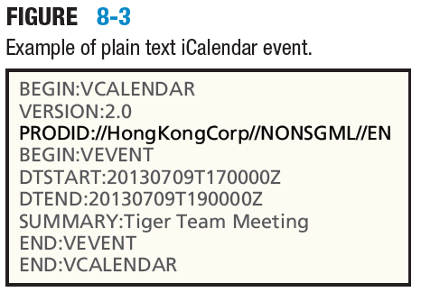
Collaborative Technologies
Email
Address book, business cards, and contact management
Calendars and time management
Discussion forums
Instant messaging (IM) and texting
IM and interoperability
Presence awareness
Text messaging (or) texting
Group decision-support systems
Web conferencing
Cisco Systems, HP, etc.
Interactive video
Skype, FaceTime, and VooV Meeting

Slide 8
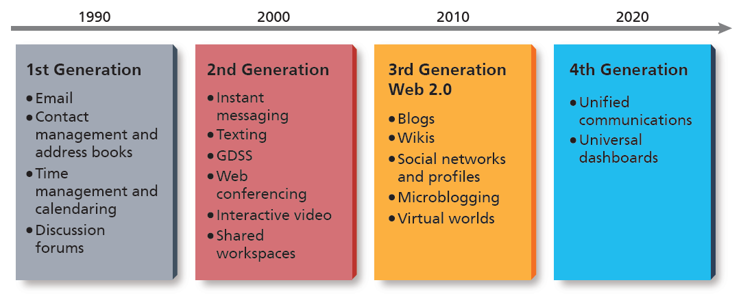
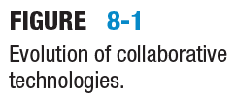
Generations of Technological Evolution

Slide 9
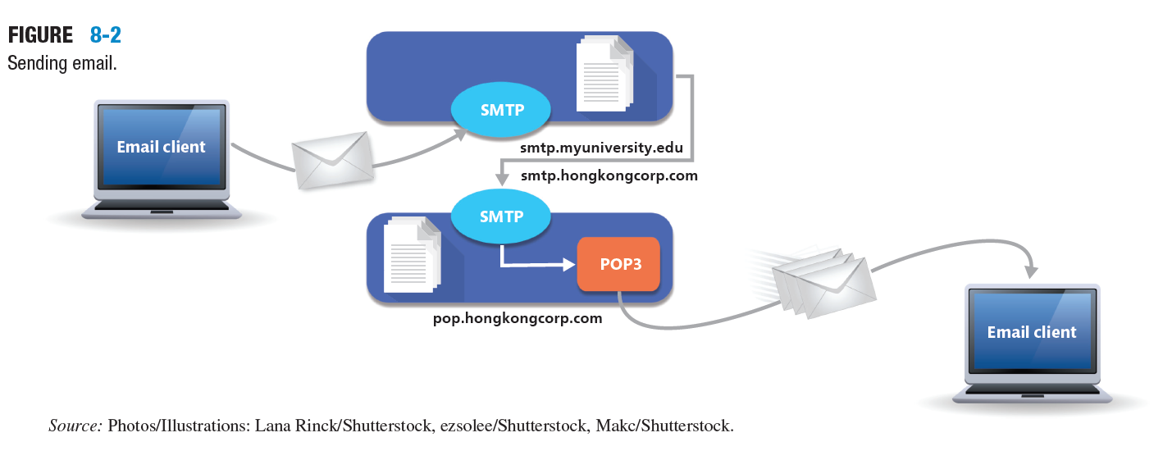
Sending Email

Slide 10
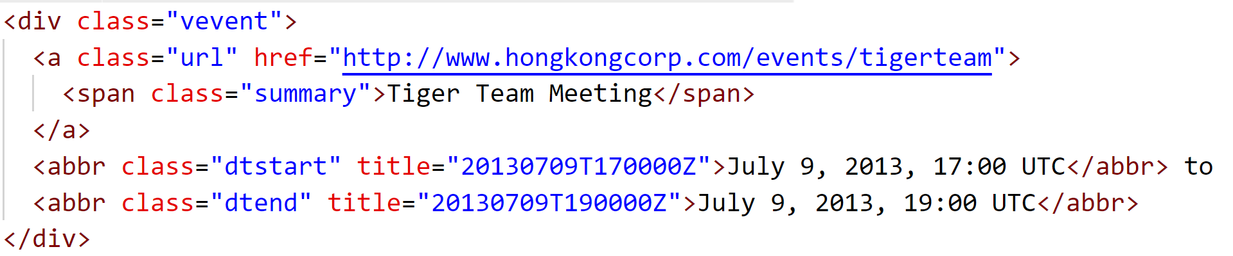
Terms and Definitions
SMTP server
Mail server using the simple mail transfer protocol; handles outgoing email.
IMAP (Internet Mail Access Protocol)
A protocol for handling incoming email.
Microformats
A set of formats that rely on the XML family of standards to represent metadata in HTML code and that support electronic exchange of business cards, calendar appointments, and other kinds of data.
FIGURE L-1
Microformat representation of the event on Figure 8.3.

Slide 11
Discussion Forums
Used for personal, academic, and business interactions
Forums enable:
The sharing of information
Coordinating activities
Posters and interactive responses
Forums need:
Moderating of user generated content
Users can:
Read, see, and comment on posts
Initiate threads (posts)

Slide 12
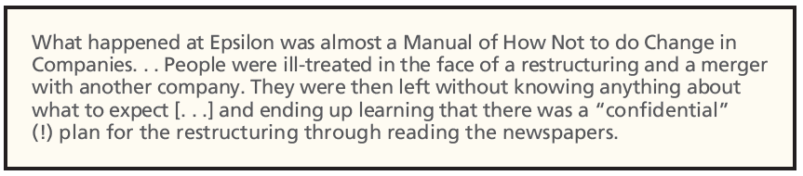
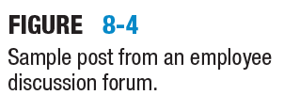
Discussion Forums

Slide 13
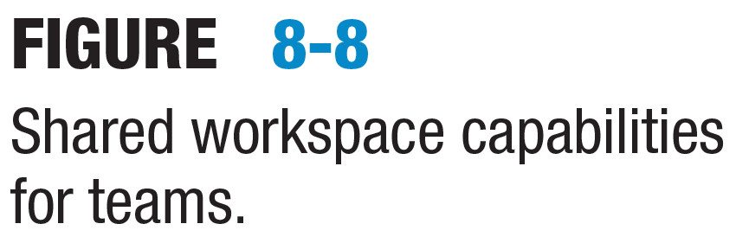
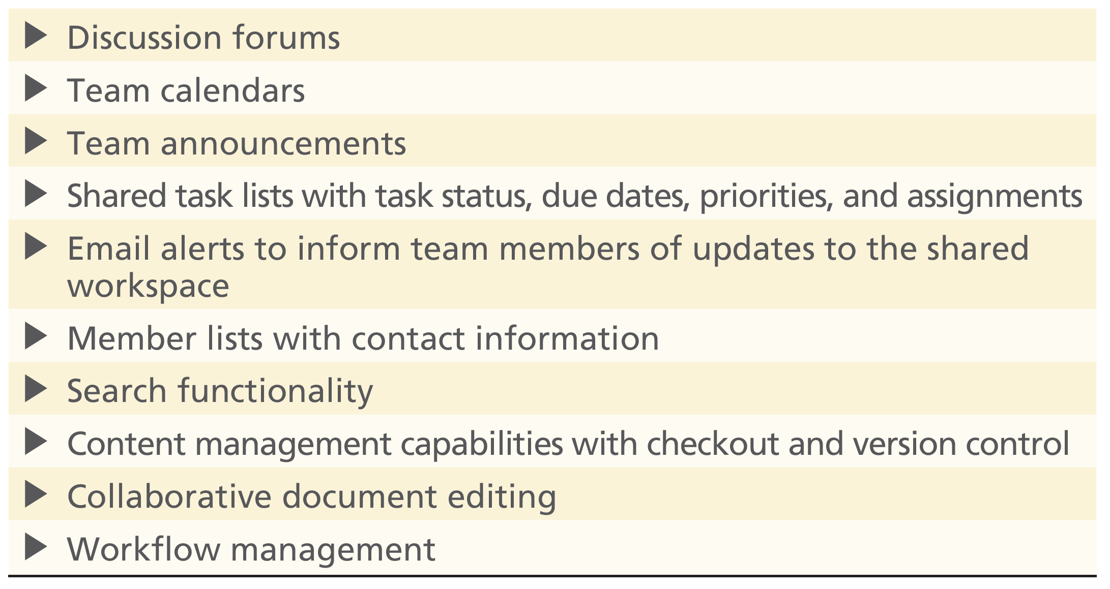
Shared Workspaces
A shared workspace is a virtual partition on a server
A Shared workspace enables:
Documents, lists, and information storage (for example)
Microsoft Sharepoint
OneDrive
Google Drive
Dropbox, etc.
Document library

Slide 14
Shared Workspaces
Shared workspaces and capabilities for teams:
Discussion forums
Team calendars
Team announcements
Shared task lists with task status, due dates, priorities, and assignments
Email alerts to inform team members of updates to the shared workspace
Member lists with contract information
Search functionality
Content management capabilities with checkout and version control
Collaborative document editing
Workflow management

Slide 15
Instant Messaging
Factors in instant messaging technologies:
Presence awareness
Text messaging
There are important considerations
In traditional ‘face-to-face’ personal communication:
There are natural inhibitions in interactions
In instant messaging and social media:
Inhibitions are reduced
Disinhibition is often a feature of instant messaging and social media
Users also fail to meet legal and statutory requirements

Slide 16
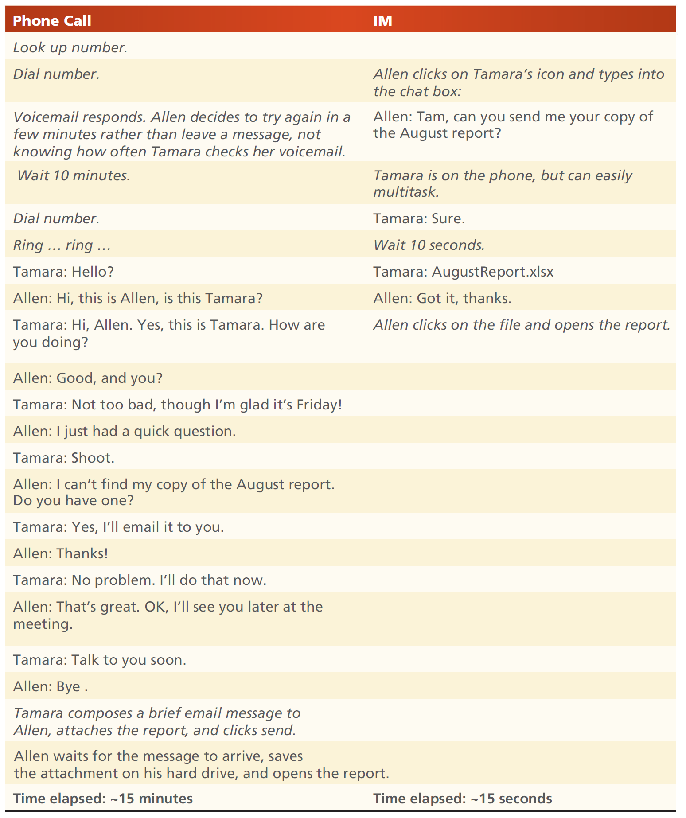
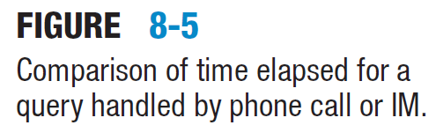
A Time Comparison
Example of time elapsed for a query handled by a phone call and IM:
The relative time taken for telephone call and an instant messaging system
Telephone call → 15 minutes
IM → 15 seconds
The relative efficiency of the methods is clear

Slide 17
Collaborative Technologies
Group decision support systems:
Collaborative technology that helps groups brainstorm and make decisions in face-to-face meetings, led by facilitators. Participants can contribute anonymously
Web conferencing:
Live meetings via the Internet:
Includes: real-time video, chat rooms, presentations

Slide 18
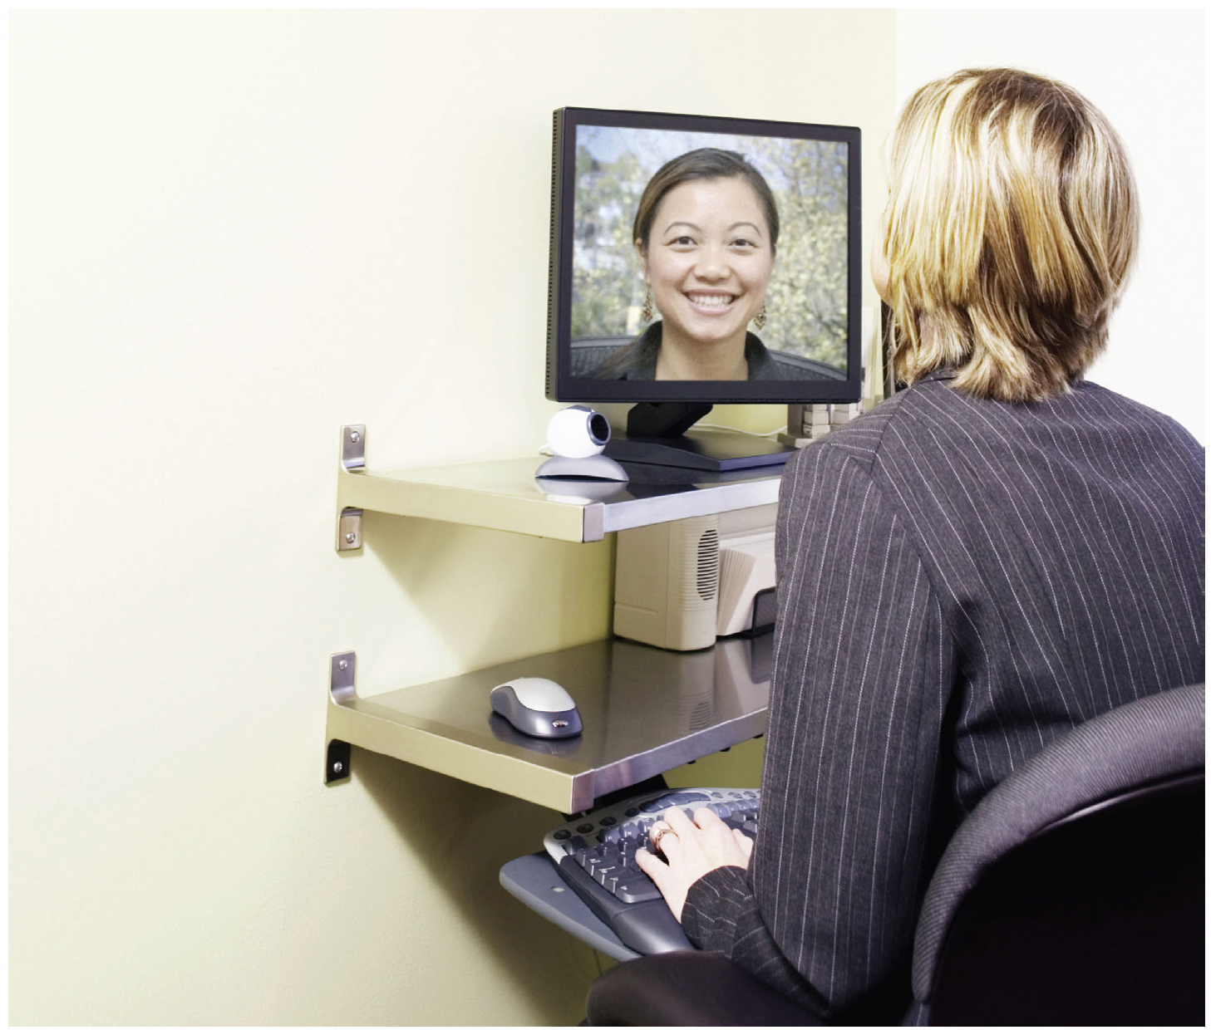
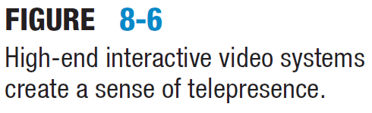
Interactive Video Systems
Real-time Interactive systems
Chats for collaboration
Telepresence
Examples include:
Simple systems for general use
Professional systems

Slide 19
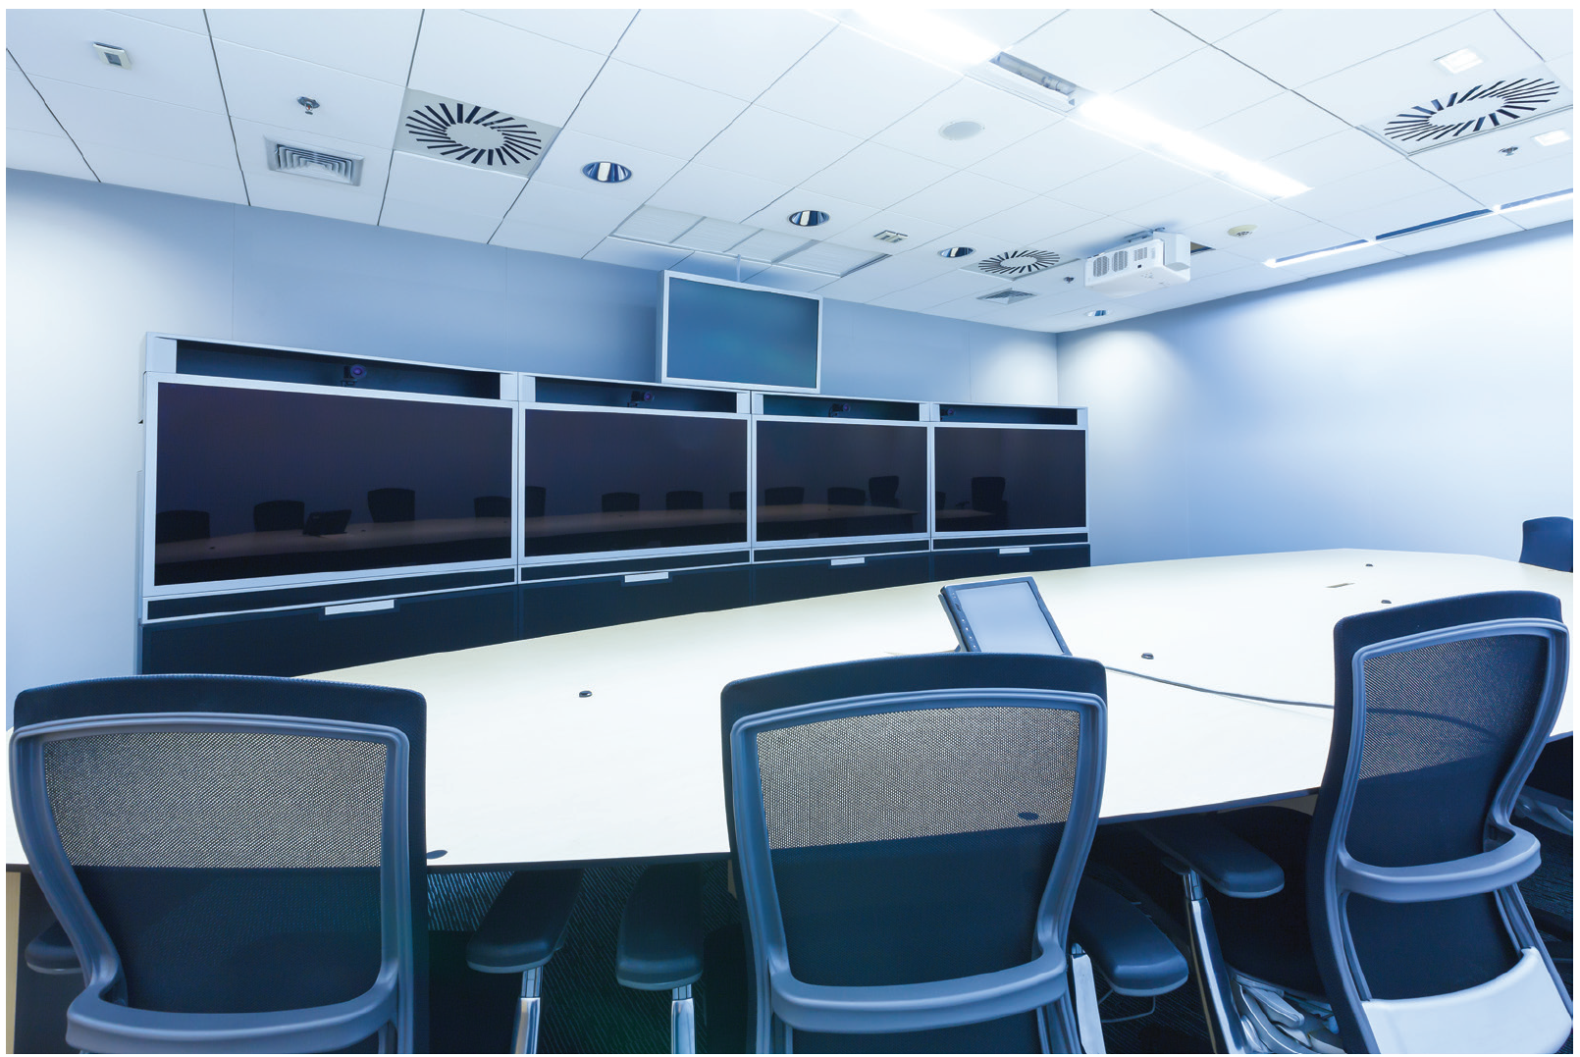
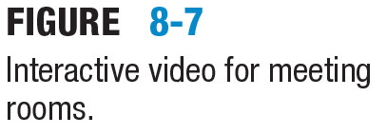
Virtual Collaborative Working
A virtual boardroom
Virtual meetings
Interactive video
Computer Supported Collaborative Working (CSCW)

Slide 20
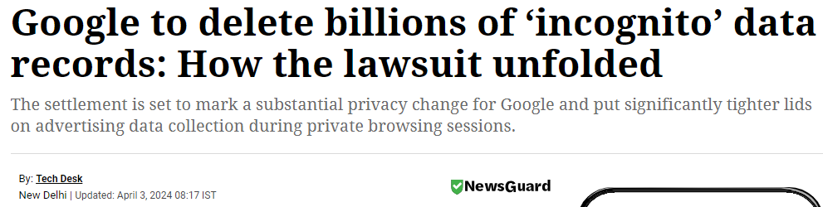
Email and Privacy Considerations
When you delete email, remember that copies are stored elsewhere, such as on the server’s backup media. Legal authorities can retrieve it, and so can employers if it is company email.

Slide 21
Definitions
Use proper spelling and grammar in your communications at work, at least until you’re sure you have a clear understanding of the corporate culture.
Avoid “textisms”, such as “cul8tr” (see you later).
Presence Awareness
Feature that allows users to display their current status to their contacts, colleagues, or buddy list.
War Room
A large area in which team members on the same project work closely together
Facilitate meetings with whiteboards, large digital displays, and other tools

Slide 22
Terms and Definitions
Shared Workspace
An area on a server in which team members can post documents, maintain membership lists, feature news and announcements, and collaborate on edits and updates.
Telepresence
The impression created when remote participants in an interactive video meeting are almost life-sized and vividly clear; useful for sensitive negotiations.

Slide 23
Web 2.0 Collaborative Technologies

Slide 24
Blogs
Blogs (short for web log) is a website with:
An ongoing commentary
Images
Links
Some blogs are personal hobbies, and others are online magazines
Organizations use blogs:
To build knowledge
For marketing and communications
Frequent updates are necessary

Slide 25
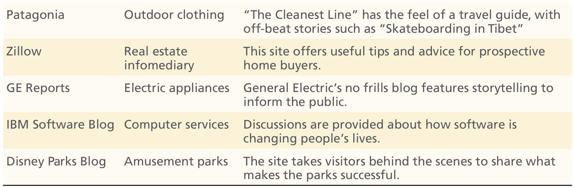
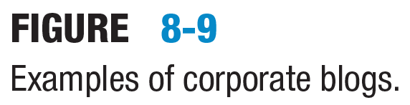
Typical Corporate Blogs

Slide 26
Wikis
Web software frequently used to build knowledge bases that allows users to add and edit interlinked web pages.
Wikis can be found in a range of applications which include:
Encyclopedia publications (e.g., Wikipedia)
Websites designed to provide information
Wikis provide a basis for interactivity including:
Users adding, editing, and commenting on interlinked pages
Organizations use wikis:
To centralise documents and store knowledge
Needs to be updated to reflect the current state of the organization

Slide 27
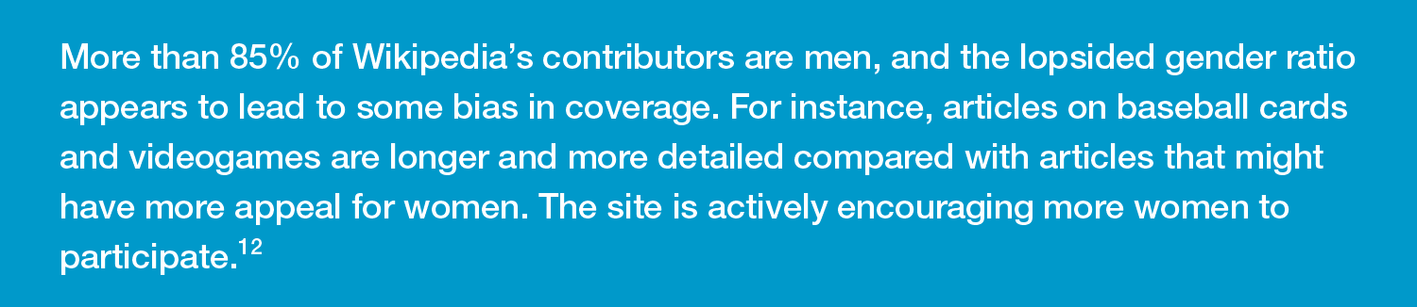
Bias on Wikis

Slide 28
Social Networking
Social networking is made possible by Web 2.0 technologies
Recognised as platforms there are many social networking applications with a global reach
The first social network was arguably Facebook, but many have started and closed over time
The primary purpose of social networks was personal communication and knowledge sharing between individuals and groups
However: social network platforms have evolved into:
Marketing pages
Fund-raising pages
Social program pages including non-profit promotional activities

Slide 29
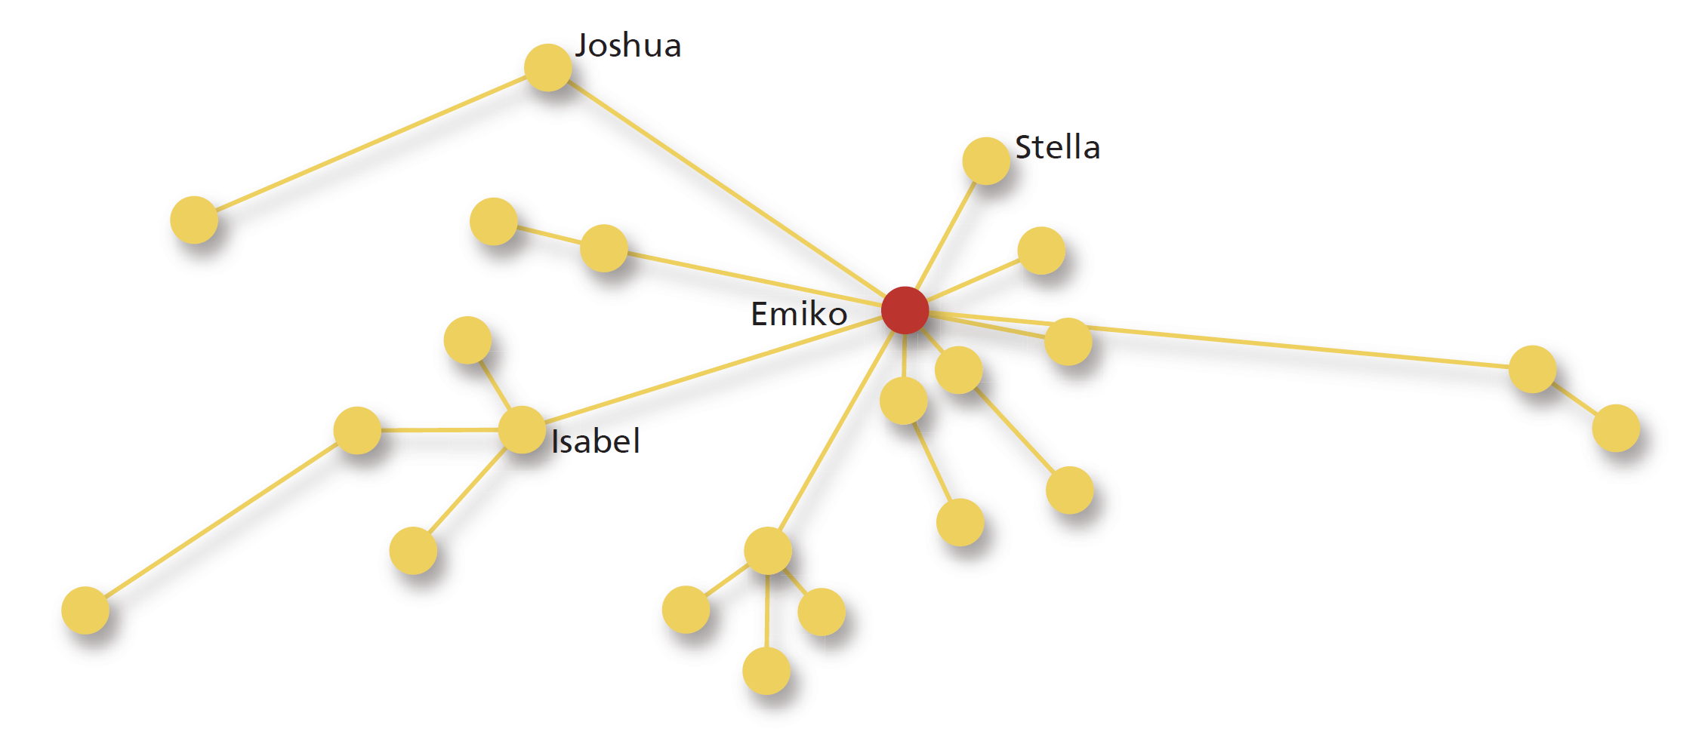
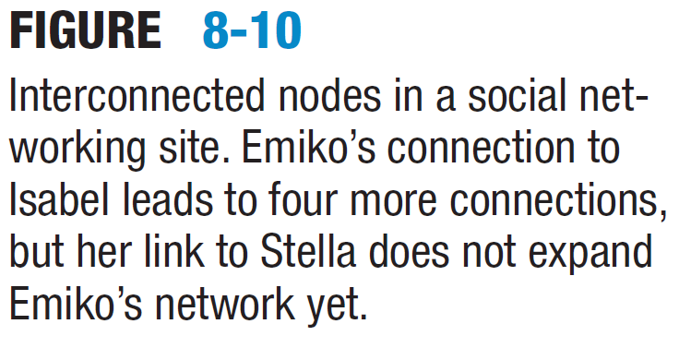
Social Networking

Slide 30
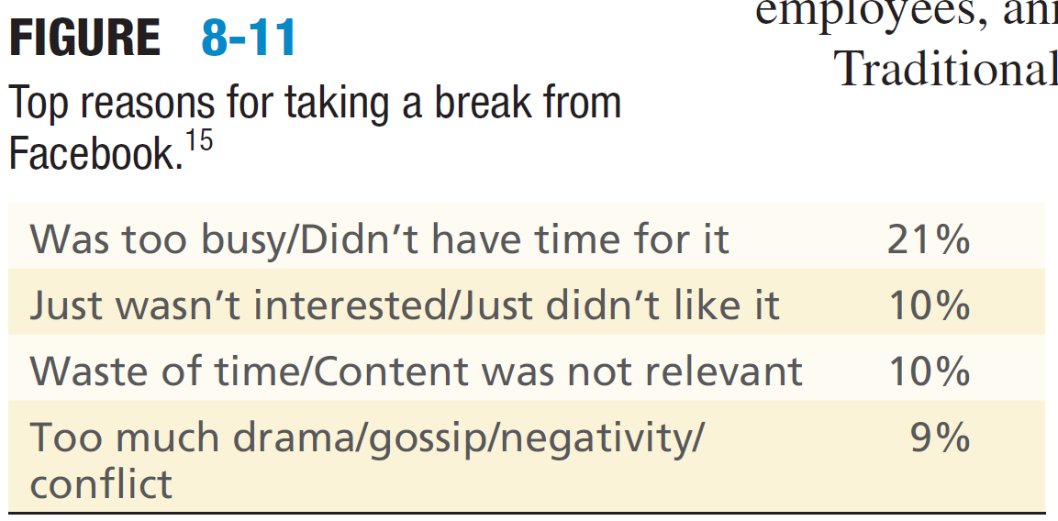
Facebook Usage (2013)

Slide 31
Microblogging (1)
Microblogging is a form of blogging in which:
The posts are quite short, containing a brief sentence fragment and perhaps a link to another web resource or video
A typical application is Twitter with links using hashtags (a keyword with #)
Twitter is used for personal uses and for marketing
Twitter has developed into a platform used for political influencing activities, and corporate blogs and lobbying
Etc.

Slide 32
Microblogging (2)
As in a blog:
Entries appear in reverse chronological order
Topics range widely, from simple personal updates to headlines from the New York Times or announcements from General Motors
The social media aspect exists because users can follow other users, whose posts constantly appear on followers’ computer screens or mobile devices:
Followers can reply to posts or repeat them for the benefit of their own followers
Often used by organizations for marketing

Slide 33
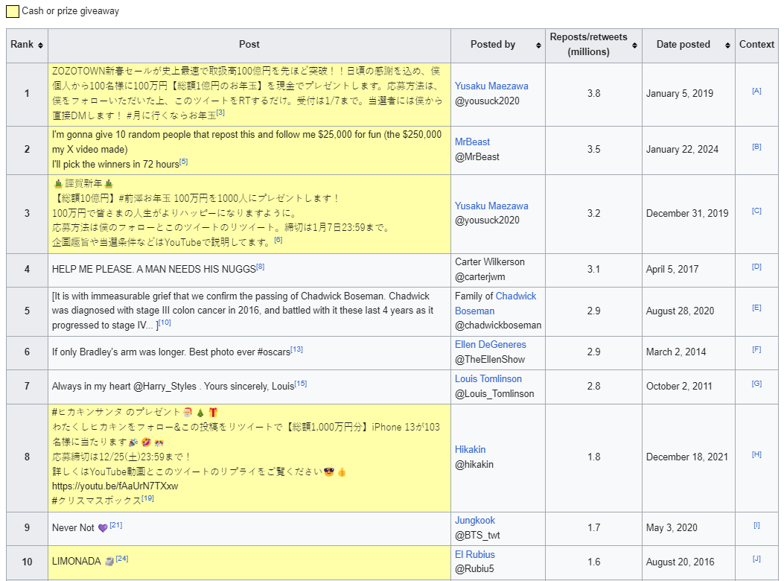
List of Most-Retweeted Tweets

Slide 34
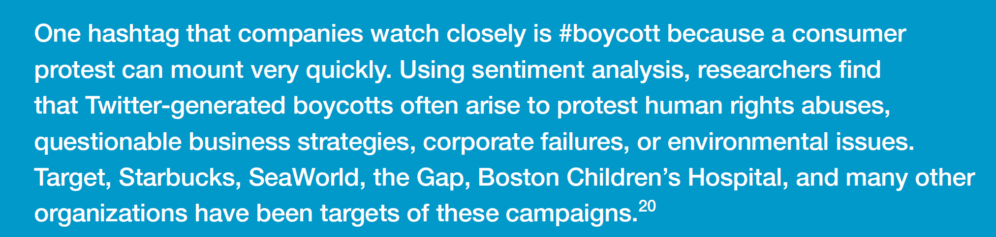
Hashtags to watch
Cancel is another hashtag that organizations should pay close attention to

Slide 35
Web 2.0 Collaborative Technologies
Virtual Worlds

Slide 36
What is a Virtual World
A virtual world is essentially a:
Graphical (generally a 3D) immersive environment where users can interact with virtual objects and with one another using avatars
Originally developed for computerised systems:
Virtual world applications were controlled with a keyboard, mouse, joysticks, console, steering wheels, or foot pedals, etc.
Users can explore digitally constructed worlds or pilot vehicles through realistic terrain
Users can also change the camera perspective to see their own avatar (that could be fantastical or quite lifelike)

Slide 37
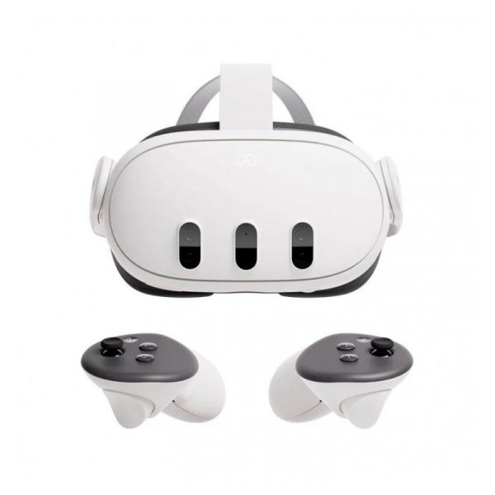
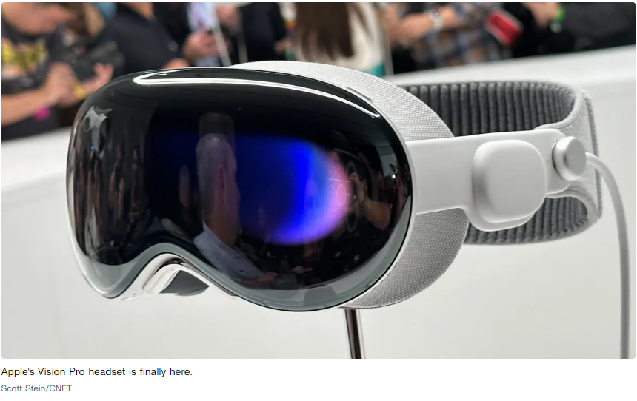
Virtual Reality
Virtual world environments have developed into what has been termed virtual reality (VR):
Virtual worlds are viewed using VR headsets
Such systems are being developed by all the major payers in the field
Top image → “Meta Quest 3”
Bottom image → “Apple Vision Pro”
Meta Quest for Business
Service that offers special enterprise-level features and customer support
Enables the management of VR headsets at the user, application, and device levels

Slide 38
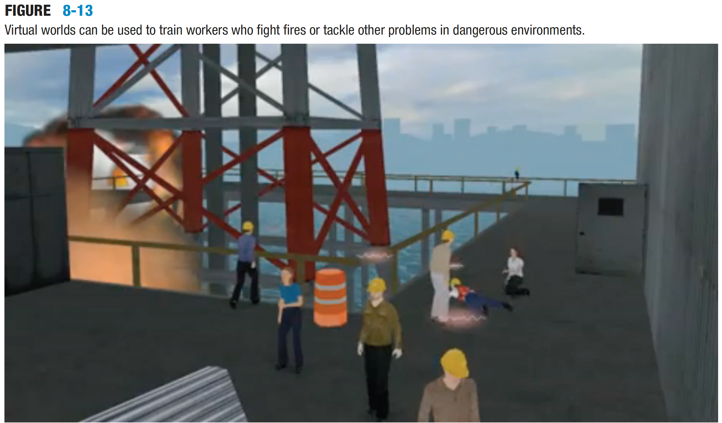
Virtual World Example
Graphical environments
Typical applications:
Training
Education
Second Life
Business conferences and meetings

Slide 39
Virtual Worlds
Virtual world applications:
Are data intensive systems and can require significant investment in systems and training (but)
Virtual worlds present opportunities for interactive collaboration
Business users:
Want to hold meetings are attracted to them to simulate a live virtual conferences with:
Speakers
Breakout rooms
Small-group sessions

Slide 40
Unified Communications

Slide 41
Unified Communications - Definition
A significant leap in collaboration is less on the standalone technologies and more on their transparent integration and user engagement
Unified communications merge diverse applications and communication streams into one cohesive interface, available across a multitude of devices. It's not that the technology is novel; rather, it's the unified strategy that knits together real-time interactions

Slide 42
Capabilities for Unified Communications
Voice calls
Conferencing (audio / video / Internet-based systems)
Messaging (email / voicemail)
Instant messaging
Presence awareness
Context-awareness and situational awareness:
Location awareness with the current context (or state)
Universal dashboards
Help users manage and access communication technologies

Slide 43
The Human Element and Collaborative Technologies

Slide 44
People and Collaborative Technologies
Communication Dynamics
Digital interaction lacks nonverbal cues, leading to potential miscommunication.
Online vs. Face-to-Face
The digital setting influences behaviour differently than physical environments.
Recognizing and adjusting to the unique aspects is key
Developing digital social skills is essential to prevent misunderstandings and foster productive online interactions

Slide 45
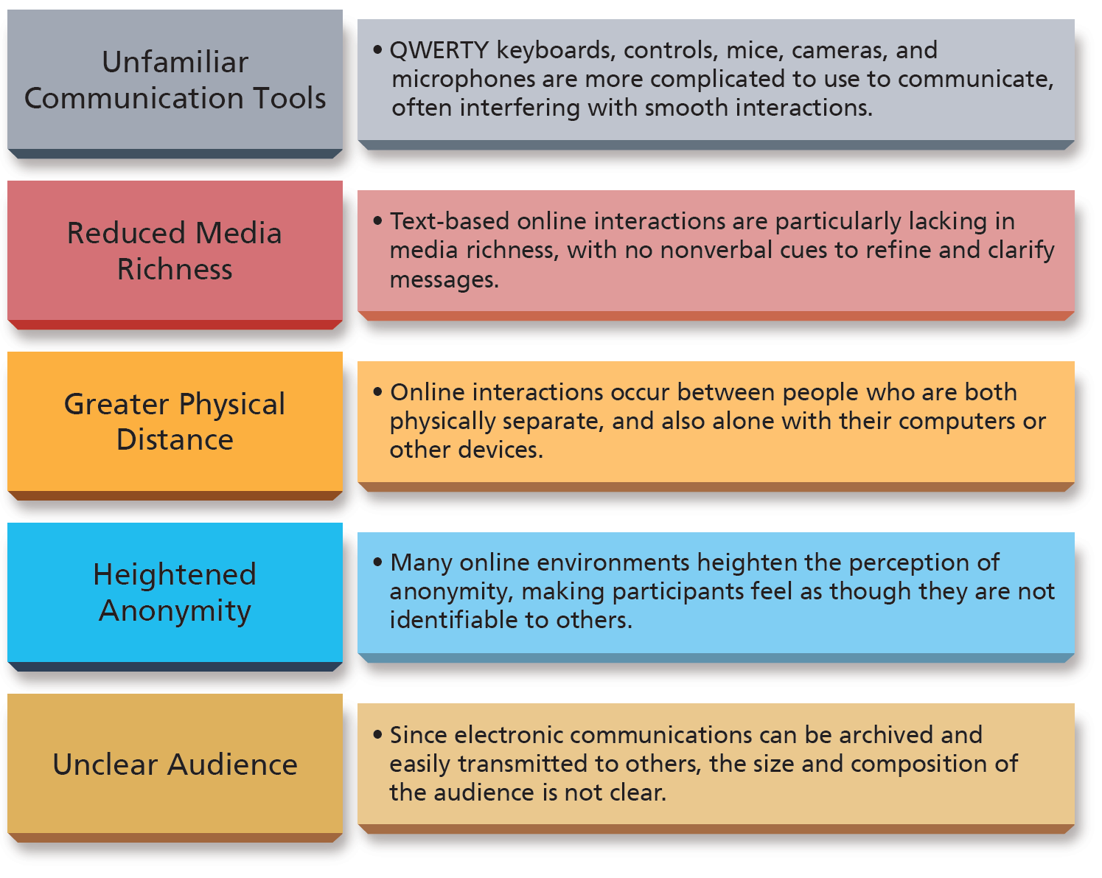
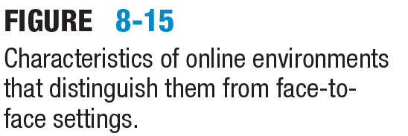
Characteristics of online environments:
That distinguish them from face-to-face settings

Slide 46
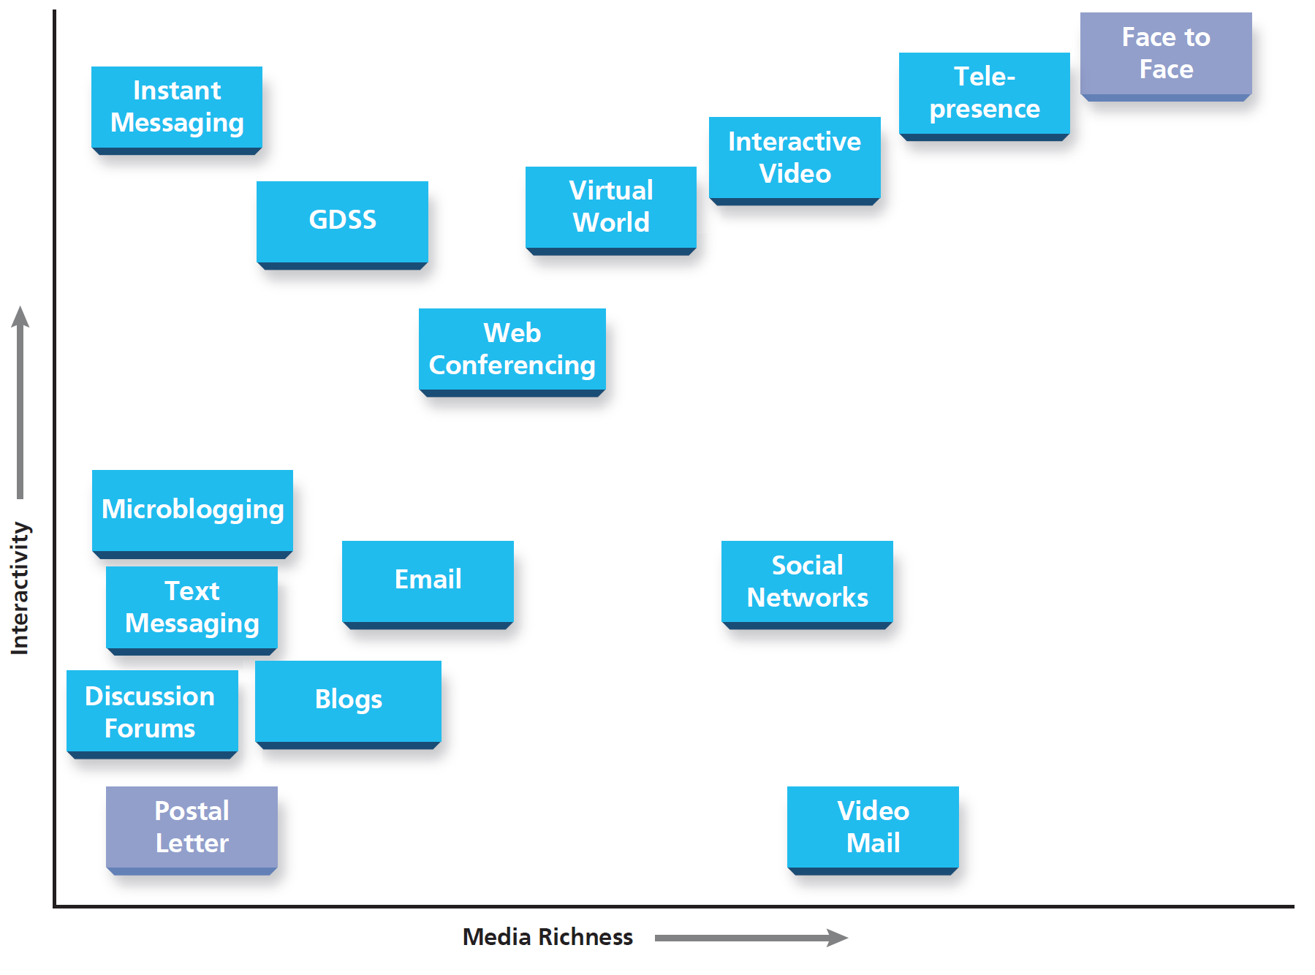
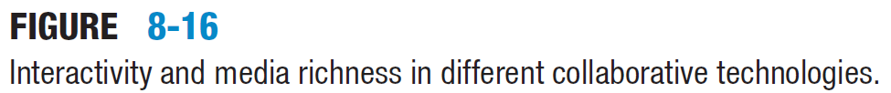
Media Richness and Interactivity

Slide 47
Managing On-Line Impressions
This aspect of unified communications has an important role:
People are increasingly working from home or are using interactive systems (e.g., VooV Meeting)
People are ‘dressing’ their home office environment where a ‘suitable background’ is important
Similarly: office environments are being ‘dressed’
People are using ‘introductory’ emails and other ways to build relationships
People form impressions using social categories
Miscalculations are common online
Social media provide photos and the ability to view networks

Slide 48
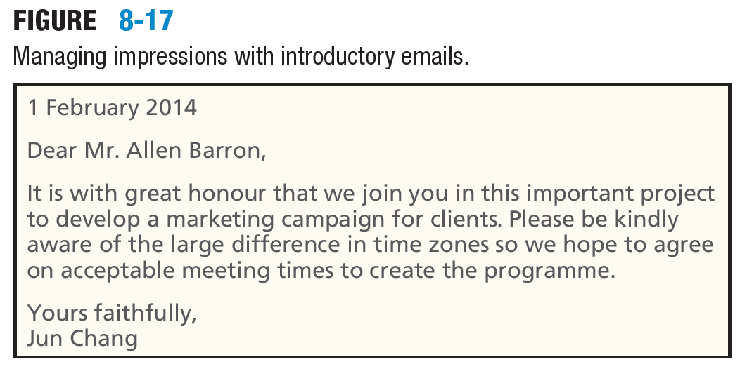
People and Collaborative Technologies (3)

Slide 49
Virtual Team Dynamics
Collaborative technologies to utilize global expertise
Reduced travel costs and diverse team composition
Challenges in establishing norms due to lack of nonverbal cues
Usually there is an increased bluntness or aggressiveness in communication
Importance of explicit communication and written agreements
Trust is harder to establish without physical interactions
Strategies for building swift trust include task orientation and clear communication
Development of team charters to outline expectations and roles
Importance of an initial face-to-face or video meeting to foster trust

Slide 50
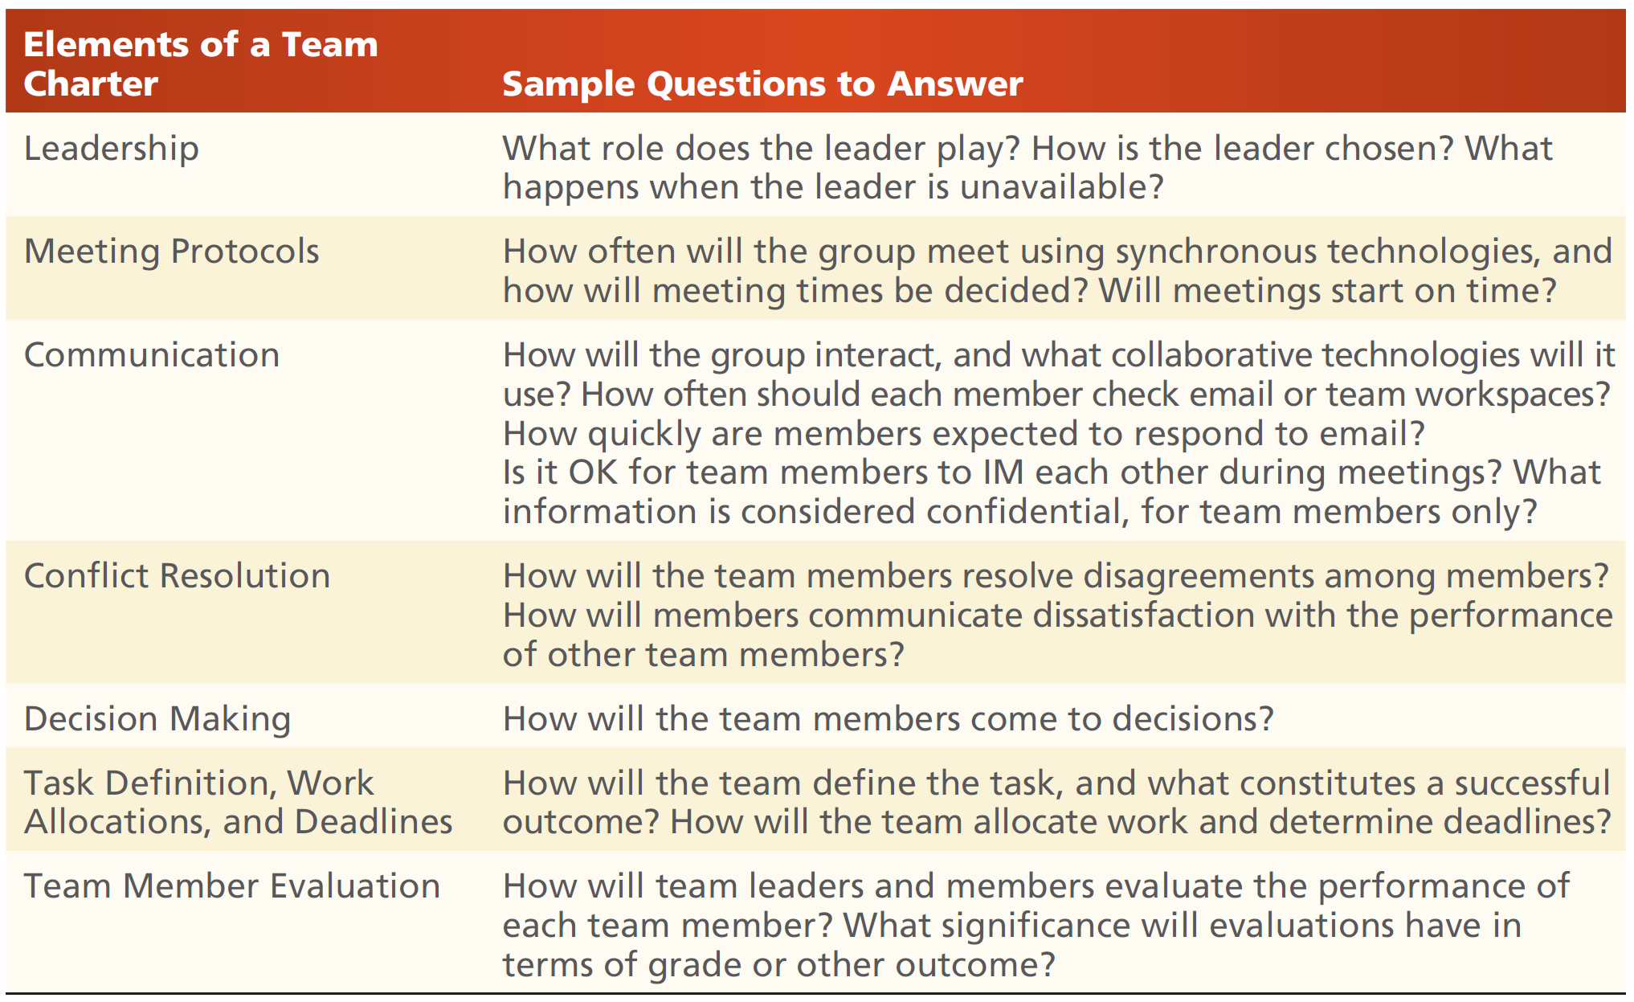
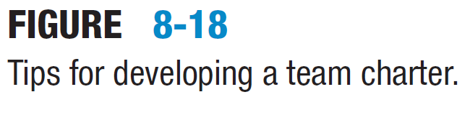
Group Dynamics in Virtual Teams

Slide 51
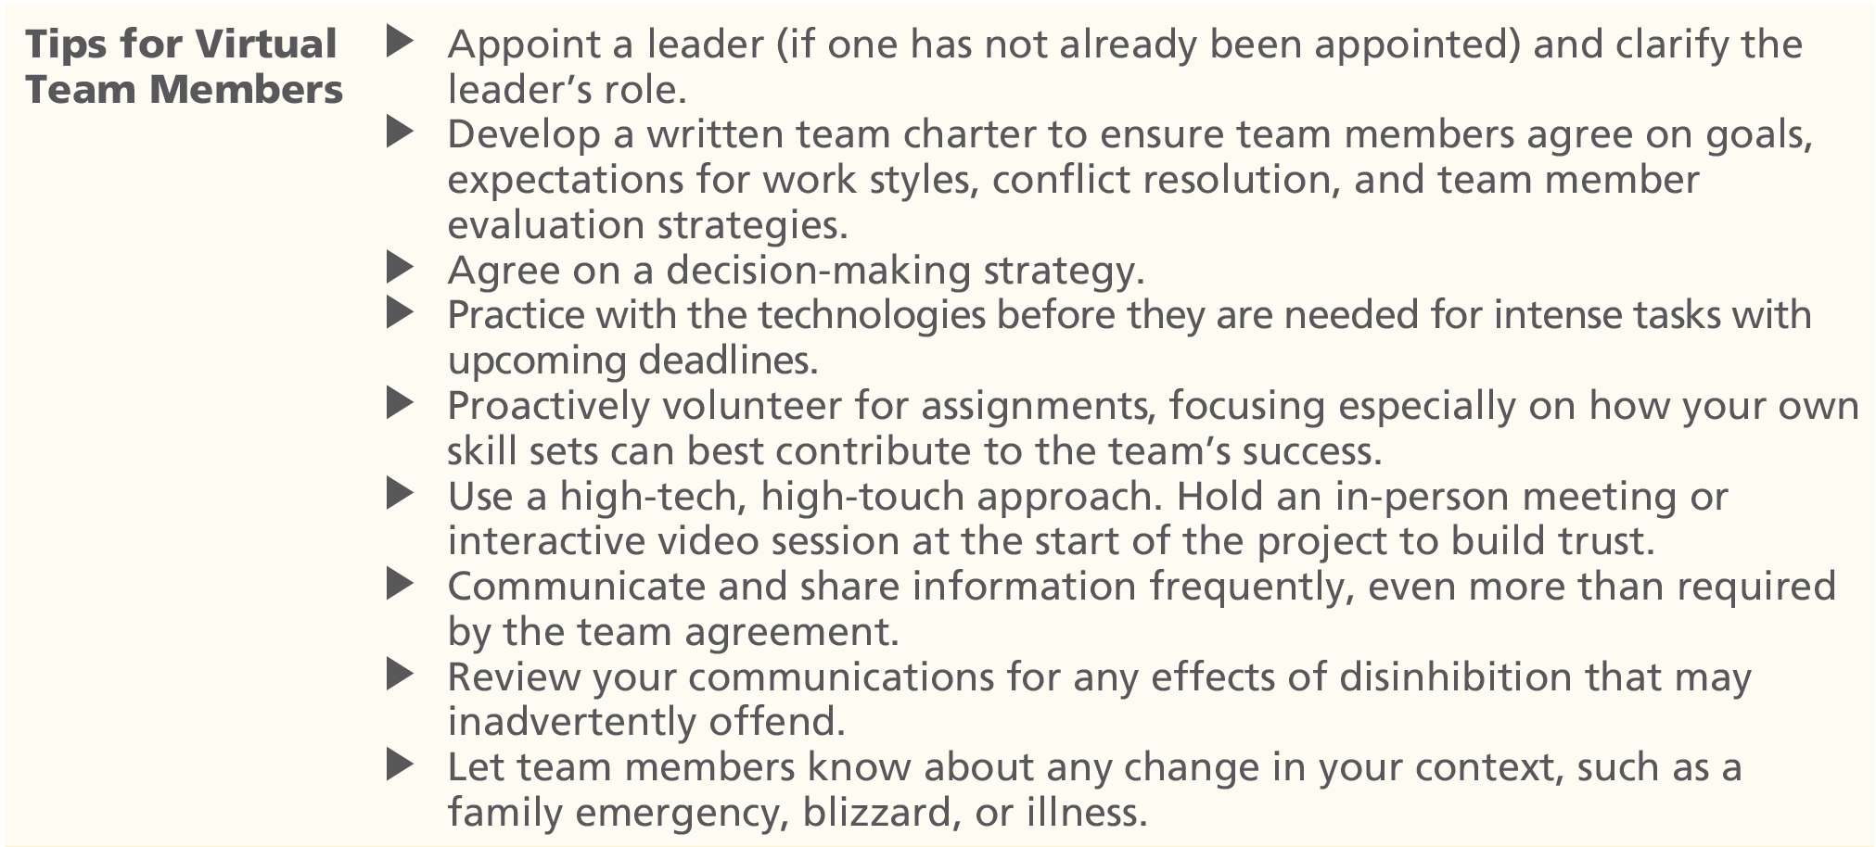
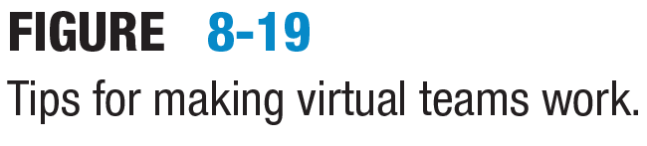
Forming Virtual Teams (1)

Slide 52
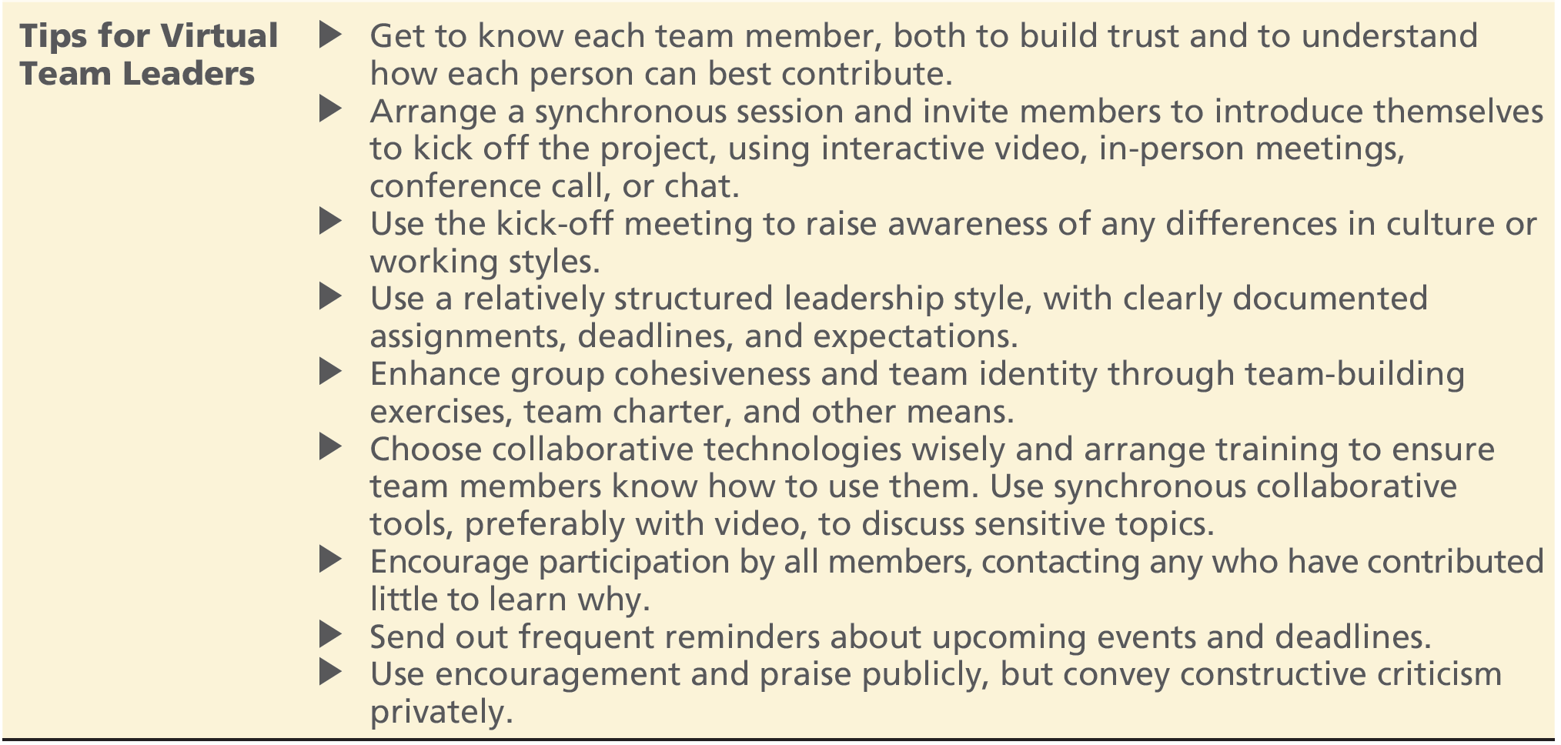
Forming Virtual Teams (2)

Slide 53
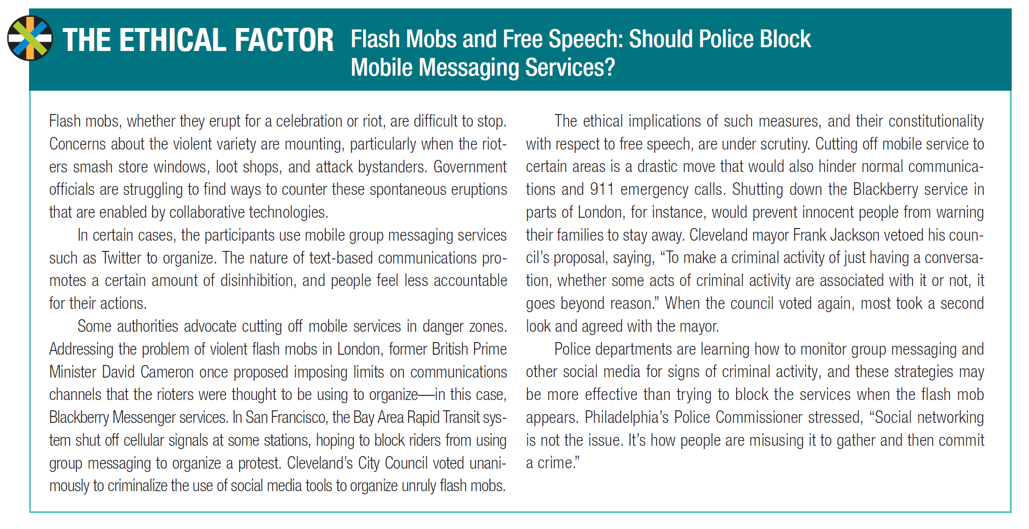
Ethical Considerations

Slide 54
Practical Advice and Productivity
Choose your communication channel wisely
Sensitive / completely confidential → text-based communication is a poor choice
Switch to the phone, interactive video, or face-to-face if text is confusing or tense
Employers often visit a candidate’s social networking site as a screening tool
Consider the impression it makes on different audiences and watch your privacy settings
Student project teams usually conduct a great deal of their work online, through email, text messages, and shared workspaces
A team charter may help establish norms that build productivity and trust, avoiding misunderstandings
For interactive video sessions consider the position of the lens
A little below eye level will enhance height without creating a threatening look
To simulate eye contact (to make a strong point), look directly into the lens

Slide 55
Chapter #8: Review and Coursework

Slide 56
Chapter #8 Review
Chapter #8 has introduced:
Collaborating with technology
Web 2.0 collaborative technologies
Unified communications
The human element and collaborative technologies
The ethical factor
In the following slides we set out:
Chapter #8 reading and coursework
Chapter #8 review questions, projects and discussion questions, application exercises, and case studies

Slide 57
Chapter #8 Reading and Coursework
Read and understand the key terms and concepts
Work through the:
Chapter review questions
Projects and discussion questions
Application exercises:
To be completed in the next laboratory session and as homework
Read and consider the (two) case studies and answer the related discussion questions

Slide 58
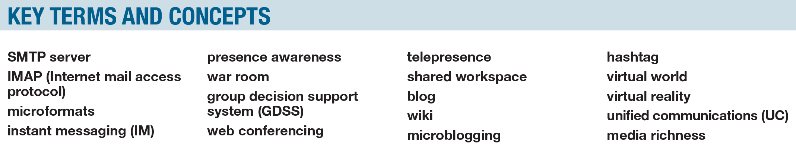
Key Terms and Concepts

